Slide 1
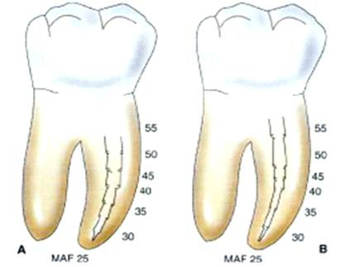
CLEANING AND SHAPING OF PULP SPACE – OBJECTIVES , STRATEGIES & TECHNIQUES

Slide 2
Success in endodontic treatment depends on how well the pulp space is shaped and cleaned
The current concept
Is not cleaning & shaping
Shaping and cleaning
Shaping – is the development of a logical cavity preparation that is specific for anatomy of each root

Slide 3
OBJECTIVES OF CLEANING AND SHAPING
Clinical objectives
Shaping facilitates cleaning by removing restrictive dentin
Allowing effective volume of irrigation to work deeper & circulate into all aspects of the root canal system
Development of logical cavity preparation specific for the anatomy
Shaping facilitates obturation
3- dimensionally cleaned & shaped root canal system is ideal for compacting Gutta-percha

Slide 4
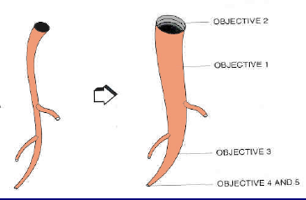
Biological objectives
Complete debride the pulp space of
pulp tissue
Bacteria / microorganisms & their endotoxins
Mechanical Objectives
Continuously tapering preparation
Maintain original anatomy
Maintaining the position of the apical foramen
Foramen as small as practically possible

Slide 5
PRINCIPLES OF CLEANING & SHAPING
Outline form
Convenience form
Sanitation of the cavity
Retention form
Resistance form
Extension for prevention

Slide 6
Outline form
It is the basic preparation throughout its length, dictated by the canal anatomy
The initial anatomy of the canal should be maintained throughout the procedure
Convenience form
The access may have to be expanded if instruments start to bind , especially as larger , less flexible instruments are used

Slide 7
Sanitation of the cavity
Meticulous cleaning of the walls of the cavity untill they feel glass – smooth , accompanied by continuous irrigation , will ensure thorough debridement
Retention from
Parallel walls in the apical 2-3 mm of the canal- ensure firm seating of the primary gutta percha point – this is where sealing against future leakage into the canal takes place
Accessory / lateral canals are most apt to be present in this region
Resistance form
Development of an apical stop at the CDJ against which filling to be completed & to resist extrusion of canal debris & filling material beyond the apex

Slide 8
Extension for prevention
Extension of the cavity preparation throughout its entire length & breadth ( peripheral enlargement of the canal ) to ensure prevention of future problems

Slide 9
Watch-Wind
Reaming
Filing
Motions of The Instruments
Quarter Turn Pull
Balanced-Force

Slide 10
Instrument manipulation / methods of using instruments
Broaches – barded & smooth
Carefully inserted through the access cavity until the dentinal walls are felt / the approximate length of the canal is reached
It is then slightly with drawn ( approx -1mm ) rotated 360 degree & removed
Note – once the hard surface of dentine walls is felt , the barded broch must not be inserted any future

Slide 11
Features of barded broach & rasps used for extirpation of the pulp

Slide 12
Reamers & files – used in reaming / a filing motion
Reaming / drilling motion
Reaming action involves placement of instrument towards the apex until some binding is felt & then turning the handle more than a full revolution
Note – Clockwise turning will remove material from the canal : where as counter clockwise turning will force material apically
Penetration Rotation ( ¼ - ½ turn ) Retraction

Slide 13
Filing / rasping motion
Placement of the instrument towards the apex until binding is felt & then moving the instrument by scraping against a side of the dentin wall with little / no revolution
Insert pressure against wall withdraw without turning
Note – Pistoing involves going up & down forcefully - this tends to pack dentinal fillings at the apex

Slide 14
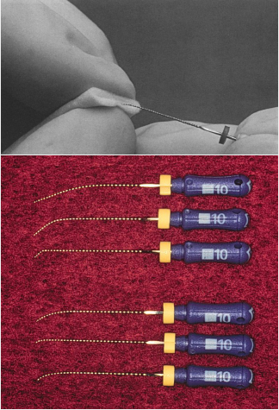
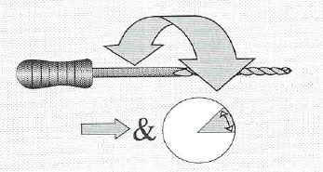
Watch winding
A clock wise / anti clock wise rotation of the instrument through an arc of 30-60 degree while advancing in the canal
With pre curved stainless steel instruments the apical part of the curved canal can be prepared with this motion

Slide 15
Circumferential filing
The instrument is moved first towards the buccal side of the canal then reinserted & moved slightly mesially
This continues around the preparation to the lingual aspect & then to distal until all dentin walls are prepared with this motion

Slide 16
Anticurvature filing
Was put forward by Abou Rass
Involves filing predominantly away from the inner curve of a root to reduce the risk of strip perforation
Filing is done in the name in the direction corresponding to the name of the canal ( e.g; mesio-buccal canal is instrumented in the mb direction in the ration of 3:1 )

Slide 17
Recapitulation
Re- instrumentation with asmaller instrument following each irrigation step
Use of a smaller instrument to remove debris produced during instrumentation
Prevents pushing debris beyond the apex & apical plug formation

Slide 18
Techniques of cleaning and shaping
Standardized technique
Step- back technique
1. APICO- CORONAL TECHNIQUES
2. CORONO- APICAL TECHNIQUES
Step –down technique
Crown down pressureless technique
3. DOUBLE FLARE / HYBRID TECHNIQUE
4. BALANCED FORCE TECHNIQUE / Roane
5. ENDOSONICS
6. LASERS
7. Non instrumentation technique (NIT) ( root canal cleaning )

Slide 19
APICO – CORONAL TECHNIQUES
Apical 3rd of the canal is prepared first using fine instruments ( size 6-15) & progressively larger instruments are used in preparing the canal coronally
Standard ized technique ( Ingle)
1st technique to be used
Required each instruments , files & reamers , to be placed to full working length
Canal is enlarged until clean white dentin shavings are seen on the apical few mm of the instrument
Filing is contiuned for further 2-3 sizes to complete the preparation
Disadvantages
In curved canals this technique may lead to
Ledging , zipping, elbow formation , perforation & loss of working length owing to compaction of dental debris
Hourglass preparation

Slide 20
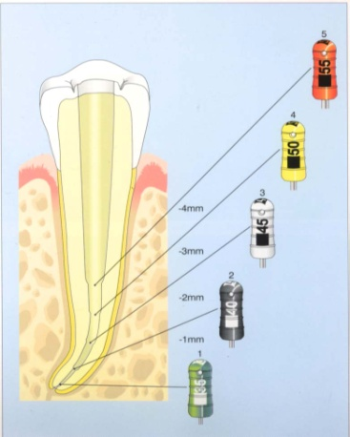
STEP - BACK TECHNIQUE (Mullaney) (Telescopic, Serial root canal prep)
Apical region is first scouted using small (6-10) sized scouting files ,& apical patency is established
The initial apical file is the largest file that snugly fits the apical constriction
The apical portion at the CDJ is then enlarged using larger sized files 2-3 sizes larger than the initial apical file - this is the master apical file
Each successively larger instrument is then inserted 1.0 mm less into the canal so that a taper is formed
In between using each larger instrument , recapitulation is done using the master apical file to the working length to clear any debris collecting in the apical part of the canal following which coronal enlargement is done
Final step of the preparation involves refining the preparation & toilet of the cavity

Slide 22
PHASE –I – Apical preparation is done upto file no .25
PHASE –II – Stepping back procedure in 1mm increments i.e., if no 25 file is used then size no.30 ,35, 40 are used in step back
Phase –III - Recapitulation is done with the no.25 file to full working length
REFINING PHASE II A –GG no 2,3,&4 – used to create coronal & mid root sections
Refining phase II B – with the no .25 file, circumferential filing is done to smoothen the walls

Slide 24
WL established ,1st active instr 8,10, 15 lubricated
Motion- watch winding – 2 to 3 turns clockwise- counter clockwise,retraction
Apical preparation upto the file #25(MAF)to full WL
With recapitulation using prior size
Stepping back in increments with recapitulation using # 25 file to ensure patency to the constriction with irrigation
(step back up the canal 1mm and 1larger instr at a time)

Slide 25
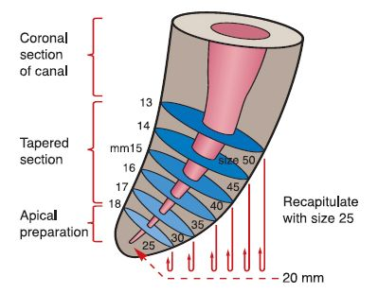

Slide 26
ADVANTAGES
Better tactile awareness
Keeps apical prep small in its original position- gradual taper- avoids apical irritation
Greater taper coronally compared to standard prep more dentin removal and cleaner walls
Early removal of pulp tissue infected necrotic debris from coronal 3rd
Avoids zipping

Slide 27
DISADVANTAGES
Chances of pushing debris into peri-radicular tissues
WL likely to change as canal curvatures are eliminated

Slide 28
TYPICAL SIZES FOR INSTRUMENTATION
Maxillary anterior teeth #60-80
Mandibular anterior teeth #35-50
Single canal bicuspids #35-40
Buccal canals of maxillary molars
and mesial canals of mandibular molars #25-35
with moderate curves.
Maxillary molar (palatal canal) #50-60
Severely curved fine canals #20-25
Severely curved large canals #35-45

Slide 29
CORONO-APICAL TECHNIQUES
Starting at the cervical orifice with larger instruments & gradually progressing towards the apex with smaller & smaller instruments

Slide 30
STEP – DOWN TECHNIQUE ( CROWN – DOWN ; MARSHALL)
Principle - coronal aspect of the root canal is widened & cleaned before the apical part .
GG is used to enlarge the canal orifice followed by the use of larger sized instruments

Slide 31
ADVANTAGES
Permits straighter access to apical region of the root canal
Eliminated dentinal interferences in coronal 2/3rd making apical instruments , reducing the risk of extruding the material
Bulk of pulp tissue debris & microorganisms are removed before apical instrumentation , reducing the risk of extruding the material
Allows better penetration of irrigating solution, & serves as a reservoir of irrigant

Slide 32
Step - Back vs Crown Down

Slide 33
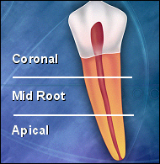
Major benefits of coronal to apical technique ( crown – down technique )
Removal of coronal obstacles that prevent canal penetration
Enhanced working length determination
Enhanced tactile feed back
Increased penetration of irrigating solutions & dissolution of tissue debris
Straight line access to root canal curvature & irregularities
Enhanced space for the coronal removal of debris during instrumentation
Ideal canal shaping that permits the successful use of all obturation methods

Slide 34
CROWN –DOWN PRESSURELESS TECHNIQUE
Basic sequence similar to step –down technique which is modified
Use of rotary systems & hand instruments with greater taper
Minimal / no pressure on the instrument as it is manipulated in the canal

Slide 35
DOUBLE FLARE / HYBRID TECHNIQUE
Coronal enlargement is done first using hand instruments
Apical preparation done by step – back technique
ADVANTAGES
Straighter access to the apical region
Eliminates dentin interference in the coronal 2/3rd , apical instrumentation accomplished quickly & efficiently
Reduced risk of extruding material through the apical foramina
Better penetration of irrigant solution
Reduced risk of zipping

Slide 36
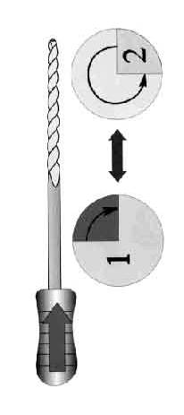
BALANCED FORCE TECHNIQUE ( Roane , 1985)
Useful while negotiating the curved root canal
Uses special flexible files with non – cutting tips ( Flex- R files).
The file is inserted into the canal until slight resistance is felt & then rotated 60 degree clockwise ( should not exceed 90degree) to engage the flutes into the dentin
Using slight apical finger pressure to hold the file at exactly the same depth in the canal , the file is now rotated through 270 degree in anti clock wise direction

Slide 37
Ist 60 degree of this cuts off the dentin engaged in the flutes of the file , the reminder of the movement picks up this dentin in the flutes of the file.
The balanced force cycle of movement should be no more than 3 times before the file is with drawn to be cleaned
The root canal system is irrigated copiously before the file is reintroduced

Slide 38
ADVANTAGES
File cutting occurs especially at the apical extent of the file
Safe ended file tip stays centered in the root when activated in phase II file cutting

Slide 39
ENDOSONICS - APPLICATION OF ULTRASONIC PRINCIPLE TO ENDODONTICS
Involves a synergistic system i e., canal preparation & cleaning , irrigation & disinfection , canal packing & filing are all accomplished with the same group of instruments

Slide 40
MECHANISM OF ACTION
1. Acoustic steaming
Mainly for cleaning
Retreatment – retrievial of silver points, posts , cements
Disadvantage – shaping using larger files (30) – zipping
2. Cavitation
They move irrigant around the canal enabling penetration to the apical most extent of the canal as well as isthmus , lateral & accessory canals
Have a synergistic effect when used with irrigants such as NaOCL by virtue of acoustic streaming

Slide 42
LASERS
Argon laser – irradiation of canal system efficiently removes intra canal debris
Nd.YAG - in combination with hand filing is able to produce a cleaner root canal with a general absence of smear layer
Advantages – lasers ablate necrotic organic materials & tissue remnants to reduce microorganisms

Slide 43
Non – instrumentation root canal cleaning
Lucci & his associates – introduced a device to cleanse the root canal “without the need for endodontic instrumentation ‘’
1st device -1993 , consisted a ‘ pump’ that inserted an irrigant into the canal , creating ‘ bubbles ’ & cavitation that loosened the debris - this pressure action was followed by a negative suction that removed debris
Disadvantage – This cleans the canal but does not shape it

Slide 44
ROTARY INSTRUMENTATION TECHNIQUE
Negotiation
Establish straight line access to canal orifice
Irrigate chamber with sodium hypochlorite
Identify canal orifice
Explore canal orifice with 10 &15 satandard0.02 taper
Take a rotary 25/.06 instrument to the depth achieved passively without violating any of the above guidelines
Coronal shaping & middle 3rd preparation with shaping files
Final finishing with finishing files
Determine the canal terminus length using an apex finder
Each file is carried passively into the canal as far as possible , without violating the general guidelines above

Slide 45
APICAL PREPARATION
Recheck working length
Gauge foramen / working length diameter by establishing the first standard 0.02 taper hand file that binds at the length required
If the canal terminus is to be terminus of the preparation , complete the apical preparation with hand GT files
If a larger apical diameter is desired complete the preparation using rotary instruments
Irrigate with EDTA
Irrigate with sodium hypochlorite

Slide 46
USAGE
Used upto 5-10 canals depending on the degree of curvature &/ or calcification experienced

Slide 47
Used with gentle pecking motion to resistance
Well lubricated canal
Flutes must be cleaned of dentinal shavings between each insertion using alcohol wet gauze
To be used to WL in relatively straight canal
Not to be taken beyond WL

Slide 48
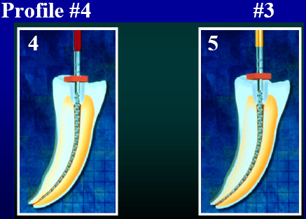
Crown Down Technique
• Step 1: Profile - brown #7
• Step 2: Profile - green #6
• Step 3: Profile - blue #5
• Step 4: Profile - red #4
• Step 5: Profile - gold #3
• Step 6: Profile - Silver # 2

Slide 49
When is Cleaning & Shaping complete?
• When you have prepared the apex to at least size 25 file
• When you have performed step-back to at least size 50
• When you have used rotary instruments to WL
• When you have achieved all Schilder’s five mechanical objectives
• When you can cone fit

Slide 50
SUMMARY

Slide 53
Hybrid technique

Slide 54
IMPORTANT QUESTIONS
Long essay
1.Define BMP & explain in detail about rationale , objectives of cleaning & shaping
2. Classify techniques of cleaning & shaping . write in detail about step- back technique
Short notes
Crow down pressure less technique
Balanced force technique
Circumferential filing
Recapitulation
Endosonics
Hybrid technique

